Slide 1
Virtual Memory
Operating System Lab-in-a-Box
Notes:
In this module, we learn about “Virtual Memory” concepts.

Slide 2
Previous
Memory
Notes:
In the previous module we learnt about “Memory”.

Slide 3
Current Presentation
Virtual Memory
Paging and Handling Page Fault
Fetching and replacing Pages
FIFO replacing
LRU Replacing
Clock like Replacing
Dynamic Locality and Working set
Working Set Model
Virtual Memory and multiprogramming
Notes:
In this module, we learn about virtual memory, paging, and replacing.

Slide 4
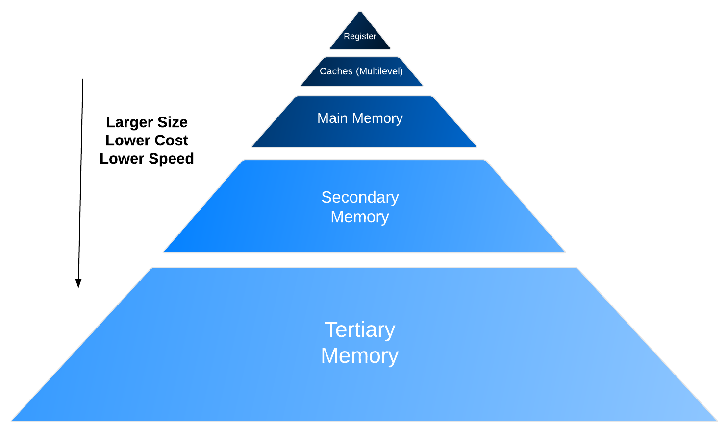
Memory Hierarchy
Register: usually one CPU cycle to access
Cache: CPU cache, TLB, Page cache
Static RAM
Main Memory: the “memory” memory
Dynamic RAM
Volatile
Secondary Memory: Hard disk
Tertiary Memory: Tape libraries
Temporal locality
Spatial locality
Memory Hierarchy – to exploit the memory locality
Notes:
Let us just look back at some of the memory hierarchy concepts we saw earlier in the module. The CPU’s access to memory satisfies “Temporal locality” and “ Spatial Locality”. Temporal locality indicates that the current value is used in the next few instructions while spatial locality indicates that a program needs data from consecutive memory locations. The data is stored hierarchically to get fast memory access time and in the order: Register, cache, main memory, secondary memory, and tertiary memory.
The registers have very fast access time of around a few nano seconds. As we move from registers towards tertiary memory, the size of the memory increases, the cost per bit comes down, and the access time increases. Cache memory has an access time of around 5 to 10 ns and stores cached data, TLB, and page cache information. It is normally a static random access memory.
The main memory has an access time from 100 ns to 200 ns, has random access and it can be dynamic RAM or static RAM. The main memory is volatile (data vanishes if the power is off).
The secondary memory is normally a semi-sequential access memory with access times of 0.5 ms to x ms. An example of this is a hard disk, this is non-volatile memory. The tertiary memory uses sequential access and an example is tape libraries and disks.

Slide 5
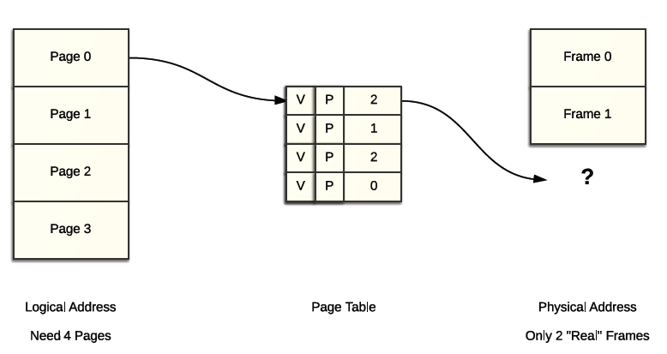
Pages>Frames?
Programmers want more processes simultaneously and bigger memory for each
What if the number of pages is larger than the number of frames in the memory?
Locality:
A recently accessed page is more likely to be accessed again shortly (temporal)
Neighbour pages of the recently accessed page are more likely to be accessed again shortly (spatial)
Notes:
The slide shows an example where we have a logical address of 4 pages and each page table has 4 entries. The number of frames in physical memory is 2, this is a typical case. Normally, logical addresses are bigger than physical addresses. The concept of locality states that the recently accessed page is more likely to be accessed again shortly (locality) and neighbouring pages of the recently accessed page are more likely to be accessed again shortly (spatial).

Slide 6
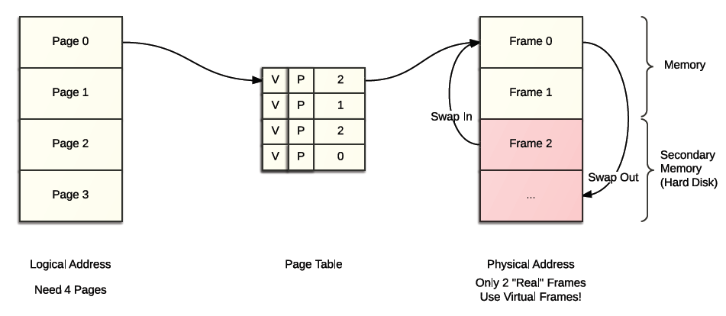
Virtual Memory
To exploit locality, use the main memory as a “cache”
Provided that the page being currently executed is in memory, it is possible to push the rest to secondary memory (swap out) and get them back when needed (swap in)
Physical address space now includes both physical memory and secondary memory
OS now has to handle all the translations and other related overheads
Notes:
Virtual memory acts as an illusion to the user and makes it appear that main memory is very large. The virtual address (i.e the logical address from the CPU/program) is mapped to a physical address in the main memory. The data in main memory is a sub set of the data from secondary memory. When the data is requested through the virtual address is not found in main memory, the right page/frame is loaded from secondary memory (swapped in) and if the main memory is full, one of the frames is swapped out and the incoming frame is loaded. The operating system handles translation (using memory management unit ) from logical addresses to physical addresses, and also the overhead if needed for swapping in and out.

Slide 7
Virtual Memory
How it works with paging:
Initialize the page table by clearing the valid bits
If a page is requested and is in main memory then proceed as usual
If a page is requested and its entry in the page table is invalid
Usually dealt with in the fault(exception)-handler way, meaning this will causes a fault and the OS has to solve it before doing anything else
If it is on the disk, get the page from the disk otherwise allocate a new frame
What if no sufficient frames?
Also a fault
Invalidate some entries in the page table, swap the corresponding pages to the main memory, and free the frames for use
Poses challenges to hardware(MMU, PT) design
Record control related information: modified(dirty bit)? In hard disk? Recently accessed?
Store them on PT or in the real frame?
Coherency problem
Notes:
This slide will mainly discuss how paging works within virtual memory. Although pure segment virtual memory does exist, it is rare and less powerful.
The page table is first initialized by the operating system or the memory management unit. If the page requested is present in main memory, then the page table shows that it is valid; it will then be obtained from main memory. If the page table shows that the page is invalid, then the page is retrieved from secondary memory and placed into main memory (swapped in). If there is no space/no free frame in main memory to swap into, then take one frame from main memory, invalidate the page table for this frame and place the incoming page into this space. If the page table shows that a the data of a page in main memory was modified (i.e. Dirty bit in PT is 1), then replace the removed page into the secondary memory. If the dirty bit is not set (indicating that the data in the frame is clean and not modified), then you need not replace it in the secondary memory when swapping out.
There will be a coherency problem if the page table shows a valid dirty bit. Then the data in main memory is good; the value in the secondary memory is old. This means data is not coherent in both main memory and secondary memory.

Slide 8
What Does (Virtual) Memory Management Do
Handle the fault
Fetch – Decide when to fetch a page, which page to fetch – is it a problem?
Replacement – Which page(s) to swap out? From the same process or not?
Resident Set – How many pages can a process have at most? How many of them can be resident in the main memory?
Good designs:
In general, utilize the locality of the memory
Minimize page faults (avoid the trap by keeping more needed pages in the memory)
Minimize I/O activities (simply drop a clean page when needed to be swapped out)
Notes:
Virtual memory management handles faults (like the page not existing in any memory), fetching page from secondary memory, decides which page to swap out, and decides how many pages per process can reside in main memory. A good virtual memory management utilizes the locality of memory, minimizes the page faults and minimizes I/O activities.

Slide 9
Handling a page fault
Block the current process
1. The frame is in the disk
OS requests a disk read to fetch the frame into main memory
Dispatch another process
Locate and fetch the page into a free frame, and when ready interrupt the OS
OS updates the page table
Unblock related process
2. If not in the disk/memory, gets harder, use the dirty bit that records if a frame is modified
Decide a frame to be swapped out
Invalid the entry in the page table
If dirty, write the frame back to the disk
If clean, drop the page (do nothing)
Allocate free frame for the new request
Update the page table
Resume everything
Notes:
A page is usually backed up in the disk anyway, but this is not necessary. A page fault is handled in the following way: If there is a page fault (i.e. the page is not in the main memory), then block the requesting process,
dispatch another process and then fetch and load the page from secondary memory to main memory into a free frame. Next, interrupt the operating system to indicate that the page is ready. The operating system updates the page table and unblocks the earlier process.
If there are no free frames in the main memory, then decide the frame to be swapped, invalidate the entry in the page table. If the dirty bit is one, write the frame back into secondary memory, if clean, just do nothing. Allocate this frame in main memory to the new request.

Slide 10
Fetching and Prefetching Pages
When?
When a page is needed
Which?
The required page
Not only on demand basis but can also prefetch some pages – prepaging
Predict which pages will be more likely to be referenced and bring them back in advance
Or fetch a group of highly relevant pages including the needed page when swapping in
Windows (prefetcher) and Linux have this feature
But still arguable if effective
Notes:
A required page (by the CPU) needs to be brought from main memory. One can also be retrieved from secondary memory, pre-fetch a group of pages around the needed page. Windows (prefetcher) and Linux have this feature. However, it is not certain whether prefetching is effective.

Slide 11
Policies for Replacing Pages
Swap out a local page or a global page? Global can seemingly avoid page faults
Swap out those with the longest time until their next access will be probably optimal.
Hard to predict and thus impractical
Policies are usually evaluated and compared using the page faults/page accesses
Generally, growing the number of frames will drop the page faults/page access towards zero asymptotically
Except the Bélády's anomaly – page fault may increase if the replacing policy violate the inclusion property
Inclusion property – if the algorithm maintains m pages in the m frame size memory, then the algorithm should include at least exactly the same m pages in any memory that has n frames where n > m.
Some practical policies: random, FIFO, LRU, clock
Notes:
Let us now look at policies for replacing pages.
Some of the practical policies are: random, FIFO, Least Recently Used (LRU), clock etc. Policies are usually evaluated and compared using the page faults/page accesses.
If we increase the number of frames, the page faults/page access drops towards zero. More Frames require larger main memory and this is not possible.
Bélády's anomaly is the observation where increasing the number of page frames results in an increase in the number of page faults.
This effect is experienced when the First-in, First-Out (FIFO) page replacement algorithm is used.
The page fault may increase if the replacing policy violate the inclusion property which means:
– if the algorithm maintains m pages in the m frame size memory, if we increase the size of memory to hold n Frames where n>m, then the algorithm should need at least exactly the same m pages in that memory.

Slide 12

FIFO Replacing
Keep a first-in-first-out (FIFO) queue and swap out the oldest pages.
Easy to implement and fair.
But tends to swap out frequently used pages and violates the inclusion property.
More frames could lead to more page faults! (Bélády's anomaly)
Frame that comes in last
3 Frames
case
First Frame that came in. Has to be replaced
Shows more page Faults
4 Frames Case
Notes:
PF: page faults
The red border indicates where the inclusion property is violated. In the figure: The first row indicates the request for the frame number.
The column indicates a FIFO queue and shows the resident frames for size 3 and size 4 memory.
Consider the 4th column, when frame 1 is needed, it is not found, hence the page fault, you replace as per FIFO policy, the green page.
At the 5th column, you need the green page again, you have a page fault, you replace the red and bring in the green…
You also find that there are more faults when the size of the memory is increased to 4 frames.
This is due to the inclusion property of Belady’s anomaly.

Slide 13
LRU Replacing
Replace the Least Recently Used page (LRU). Temporal locality implies that it will be least likely to be reused soon.
Maintains inclusion property. More frames will at least not increase page faults.
Theoretically close to optimal.
Keeping track of the sequence, is however difficult.
Notes:
Replace the Least Recently Used page (LRU). Temporal locality implies that it will be least likely to be reused soon.
This maintains the inclusion property as more frames will not increase the number of page faults.
Theoretically close to optimal.
Keeping track of the sequence is difficult.
Look at the colour blocks.
First column: Request is for block 3. There is nothing in the memory. Page fault occurs. A green block (#3) is brought in.
Second Column: Request is for block 2. Page fault occurs. Red block is brought in (#2). The blocks are moved in the LRU queue. Green is the least recently used.
Fourth Column: Request is for block 0. Page fault occurs. The green block is replaced and the light blue block (#0) is brought in. The blocks are moved in the LRU queue. Read block is the least recently used.

Slide 14
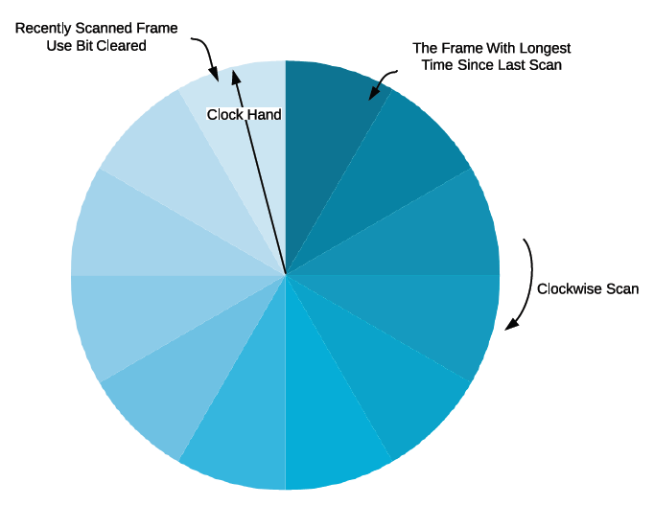
Clock-like Replacing
Approximated version of LRU. Practical and commonly used.
Use the dirty bit again. Also an additional use bit. Whenever a page is referenced to, set the use bit in the page table entry.
OS keeps a circular FIFO queue and a clock hand pointer.
Each time a page is accessed, the use bit of corresponding page table entry will be set, clock hand pointer will scan the next frame and clear its use bit.
So in terms of an individual entry, its use bit will be cleared periodically. If an entry is clear, then the page has not been used recently.
When OS is looking for a page to be swapped out, clock hand pointer scans through the cycle until it finds the first:
clean page, do not have to swap out and just drop the page or
unused page, swap it out
Notes:
A “Clock” is a more efficient version of FIFO or approximate version of LRU. The clock algorithm keeps a circular list of pages in memory. The “Clock hand" points to the last accessed page frame in the list. If there is a page fault and there is no empty frame, then the R (referenced) bit is inspected at the hand's location. If R is 0, the new incoming page is inserted at the page the "hand" points to, otherwise the R bit is cleared. Then, the clock hand is incremented and the process is repeated until a page is replaced.

Slide 15
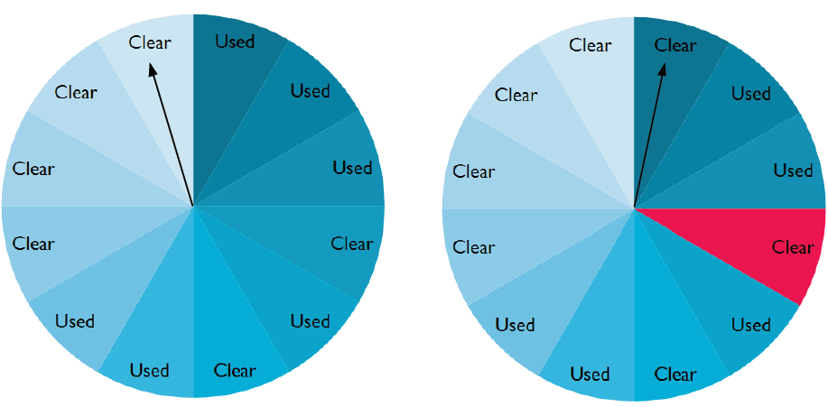
Clock-like Replacing
An access to the page will result in a move of the clock hand pointer, if the next page is not the one requested, clear its use bit. (Frame 1)
Page 4(red) will be selected if a free frame is needed as the pointer will scan through frame 2 and frame 3, finding them used.

Slide 16
Dynamic Locality And Working Set
How many pages can a process own? This is a dynamic number.
A process maintains locality and at the same time could be dynamically changing in the long run.
To capture the dynamic locality, the concept of the “working set” is proposed.
W(∆, t) – Set of pages accessed by a process over the time interval[t- ∆, t].
The working set size (WSS), generally grows with ∆.
However it is possible to identify a small enough ∆’ after which the WSS does not grow too much.
Working set will remain a specific locality for a while and then migrates to another locality. Proper ∆’ helps neglect the effect of the interlocality transitions and capture the WSS of the most recent locality.
Notes:
Peter Denning defined related concepts in 1960s.
For every process create a Working Set Size (WSS). It changes with time. Keep WSS size of pages in main memory.

Slide 17
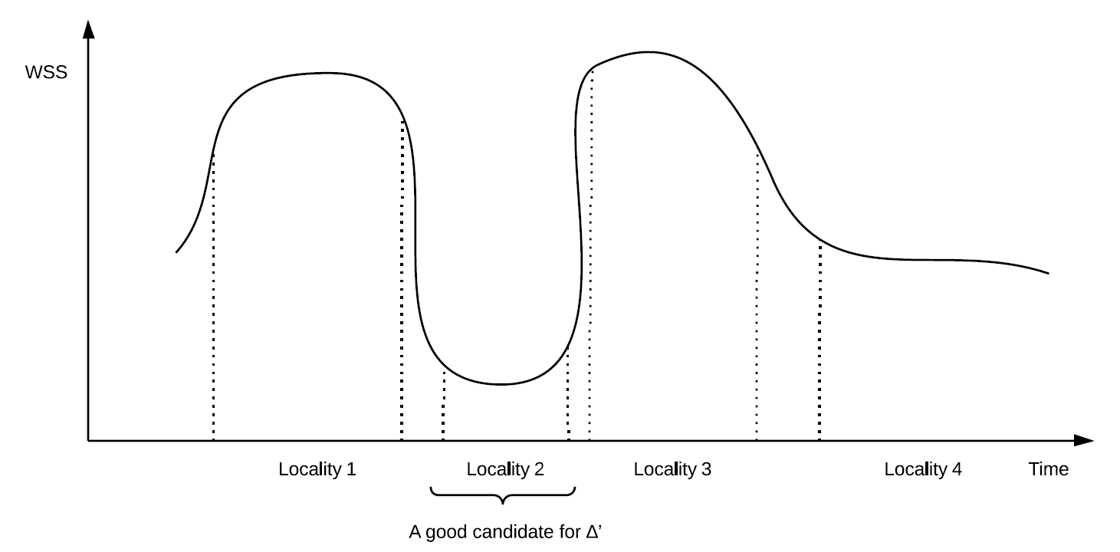
Dynamic Locality And Working Set
A process may have several distinctive working modes.
For each working mode, the WSS will reach a stable state and settle for a while.
Anything between the stable states is the transitions.
Notes:
As shown in this slide WSS settles down to a stable number after a period of time.

Slide 18
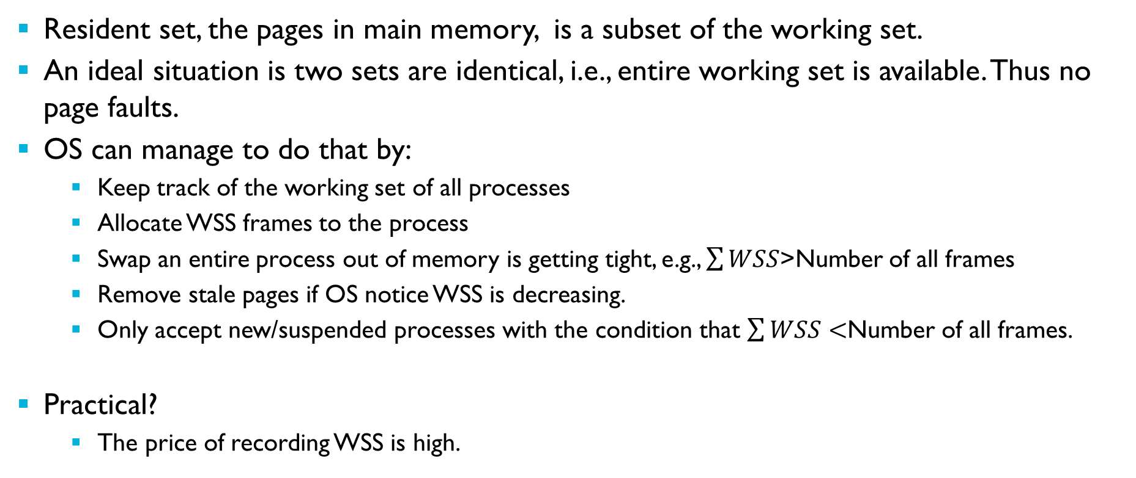
Working Set Model
Resident set, the pages in main memory, is a subset of the working set.
An ideal situation is two sets are identical, i.e., entire working set is available. Thus no page faults.
OS can manage to do that by:
Keep track of the working set of all processes
Allocate WSS frames to the process
Swap an entire process out of memory is getting tight, e.g., $\sum{WSS}$>Number of all frames
Remove stale pages if OS notice WSS is decreasing.
Only accept new/suspended processes with the condition that $\sum{WSS}<$Number of all frames.
Practical?
The price of recording WSS is high.
Notes:
If WSS number of pages are in the main memory, the page fault decreases. OS can manage to do that by:
Keep track of the working set of all processes
Allocate WSS frames to the process
Swap an entire process out of memory is getting tight, e.g., $\sum{WSS}$>Number of all frames i.e. Sum of all WSS of all processes is more than the number of Frames possible in a main memory.
Remove stale pages if OS notice WSS is decreasing.
Only accept new/suspended processes with the condition that $\sum{WSS}<$Number of all frames.

Slide 19
Working Set Model
Accept some page faults
Approximated solution:
Monitor page fault rate r
r = 1/(recent page fault time – last page fault time)
Set up an upper bound U and lower bound L
If r > U, add a page to WSS
If r < L, shrink WSS
Swap the process out if r > U and no free frames
Notes:
Here is a working set model. It is created by monitoring Fault Rate (r)
If the fault rate is below a lower boundary, then reduce the size for WSS
If the fault rate is more than a upper boundary, then increase size of WSS.

Slide 20
Virtual Memory And Multiprogramming
Conceptually increase the memory space
Increase the degree of multiprogramming as sometimes only part of the program is necessary to be loaded
As an extension of ordinary paging scheme, virtual memory better facilitates page protection and sharing
However needs explicit support from both hardware and OS.
User’s mental model is not coherent with reality as OS conceals the low level details.
Notes:
Virtual Memory concept provides an illusion that the users have an infinite space (or any amount of they reasonably need).
Proper paging schemes with good replacement policies increases memory hit. Virtual memory supports multiprogramming by loading only the required pages of the program in the main memory at any time.

Slide 21
Next
Cache
Notes:
In the next module we will study “Cache memory”.

